Slide 1
Exotic Options

Slide 2
Types of Exotic Options
Chooser Option
Compound Option
Barrier Option
Binary Option
Lookback Option
Shout Option
Bermuda Option
Asian Option
Basket Option

Slide 3
Chooser Option

Slide 4
Meaning
It is an option wherein the buyer can decide whether the option will manifest as a call option or put option on a specified date, usually few days before the expiration date.
Suitability
For hedging against a future event that is highly uncertain; an underlying whose price movements are volatile
Type of Option
European
Time of Expiration
As decided in the Contract, irrespective of the decision
Payoff
If Call exercised: Underlying price- Strike price- Premium
If Put exercised: Strike price- Underlying price- Premium

Slide 5
Exercise Price
As decided in the Contract, irrespective of the decision
Position
Decided a few days prior to expiry
Risks
Counterparty Default
Premium
More than plain vanilla bonds
Underlying Asset
The underlying using which the option is written

Slide 6
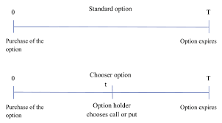
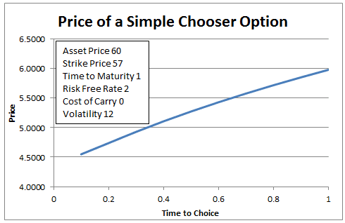
Fig 1.1: Call/Put decision timeline in a Chooser Option
Fig. 1.2: The value of a Chooser Option is more, the more the time to choose between call/put

Slide 7
Compound Option

Slide 8
Meaning
A compound option is an option for which the underlying asset is another option.
Suitability
It is more common to see compound options in currency or fixed-income markets, where an uncertainty exists regarding the option's risk protection capabilities.
Time of Expiration
2 dates of expiration
Exercise Price
2 exercise prices
Position
Dependent on the type of compound option and whether the second option (the underlying) is exercised or not.

Slide 9
Position
Dependent on the type of compound option and whether the second option (the underlying) is exercised or not.
Premium
If the compound option is exercised, then 2 premiums have to be paid; else, just 1 premium paid to buy the overlying.
Underlying Asset
The underlying is the second option; the first option is the overlying.
Types
Call on Call
Call on Put
Put on Call
Put on Put

Slide 10
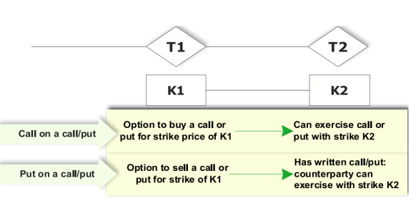
Fig. 2.1: How the 4 types of Compound Options function at two strike prices and 2 expiration dates

Slide 11
Barrier Options

Slide 12
Meaning
A barrier option is a type of derivative where the payoff depends on whether or not the underlying asset has reached or exceeded a predetermined price. The option becomes worthless or may be activated upon crossing of a price point barrier.
Suitability
Someone who wants to hedge a position, but only if the price of the underlying reaches a specific level, may opt to use knock-in options.
Type of Option
European, with respect to the barrier condition being satisfied.
Time of Expiration
As decided in the contract. However, if, in a knock out option, the barrier is reached then the option is terminated. Similarly, in a knock-in option, until the barrier is reached, the option isn’t activated.
Payoff
If the barrier condition is satisfied-
Call: Max (Spot Price- Strike Price,0)
Put: Max (Strike Price – Spot Price, 0)

Slide 13
Exercise Price
As decided in the contract
Position
Call/Put as decided in the contract
Risks
Uncertainty whether the asset price would reach/exceed the barrier set.
Premium
Less than standard options that do not have a barrier condition built-in.
Underlying Asset
As stated in the contract
Types
Knock-in Barrier options: It expires worthless if the underlying exceeds a certain price, limiting profits for the holder and limiting losses for the writer.
Knock-out Barrier options: It has no value until the underlying reaches a certain price.

Slide 14
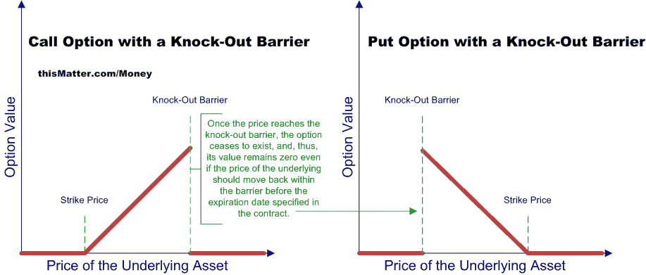
Fig. 3.1: Diagrammatic representation of a call option with knock-out barrier and put option with a knock-out barrier respectively.

Slide 15
Binary Option

Slide 16
Meaning
A binary option is a financial product where the buyer receives a payout or loses their investment, based on if the option expires in the money. Binary options depend on the outcome of a "yes or no" proposition, hence the name "binary.“
Suitability
The direction of price movement is certain, but magnitude is not.
Time of Expiration
As decided in the contract.
Payoff
It is a fixed amount (or percentage of a fixed amount) as stated in the contract
Exercise Price
As fixed in the contract.
Position
The trader can take a “Yes/No” stand, depending on his expectation of the price movement up/down. However, taking a position in the underlying is not allowed.

Slide 17
Risks
The maximum risk is the amount of investment.
Premium
Higher than conventional options
Underlying Asset
As decided in the contract
Illustration
Let’s assume stock Colgate-Palmolive Co. is currently trading at Rs. 64.75. A binary option has a strike price of Rs. 65 and expires tomorrow at 12 p.m. The trader can buy the option for Rs. 40. If the price of the stock finishes above Rs. 65, the option expires in the money and is worth Rs. 100. The trader makes Rs.60 (Rs.100 – Rs.40).
If the option expires and the price of the Colgate is below Rs.65 (out of money), the trader loses the Rs.40 they put into the option.

Slide 18
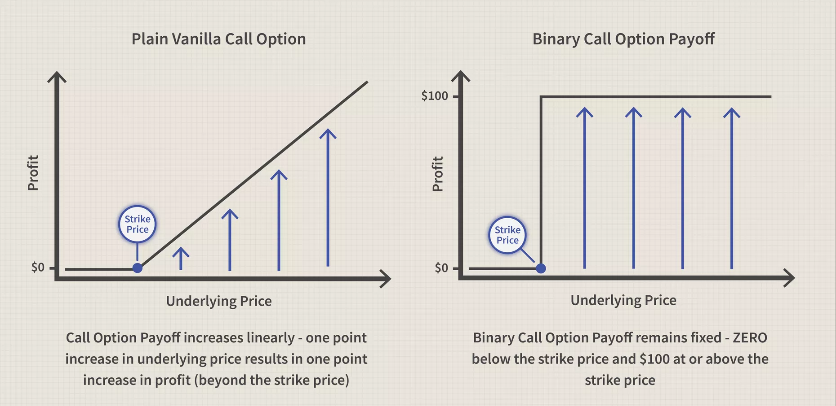
Fig. 4.1: In plain vanilla, payoff increases linearly, however in binary options, if the investors' hunch is correct then he/she stands to gain the payoff amount, otherwise the payoff is nil, and the trader loses the invested amount.

Slide 19
Lookback Option

Slide 20
Meaning
Unlike in a conventional option where the payoff is the difference between exercise price and spot price at maturity, here, the payoff is the difference between exercise price and the price (during the lookback period) that maximised the payoff.
Suitability
Trader requires certainty
Type of Option
Traded over the counter (OTC)
Time of Expiration
At the expiry date, the buyer of the option can lookback at the purchase period (say 3 months) to decide on a price.
Payoff
The maximum difference between the look back period price and exercise price. The payoff is settled in cash.
Exercise Price
As decided in the contract

Slide 21
Position
Call/Put as decided in the contract
Risks
These options are expensive to establish and the potential profits are often nullified by the costs.
Premium
Very high due to the inherent advantages.
Underlying Asset
As mentioned in the contract
Types
Fixed lookback option: Strike price fixed at purchase. Payoff is difference between fixed strike and highest past market price (call) or lowest past market price (put).
Floating lookback option: Strike price will be the lowest price during the lookback period (call) and strike price will be the highest price during the lookback period (put). The payoff will be the difference between the strike price and current market price at maturity.

Slide 22
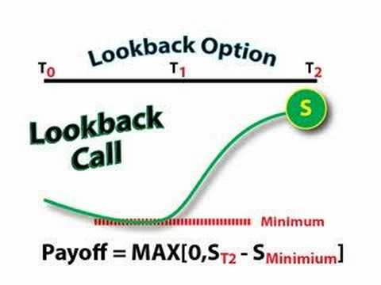
Fig. 5.1: Diagrammatic representation of a floating lookback call option

Slide 23
Bermuda Option

Slide 24
Meaning
Bermuda options allow investors to buy or sell a security or underlying asset at a preset price on specific dates as well as the option's expiration date.
Suitability
Trader requires flexibility as to when to exercise
Type of Option
Considered an alternative to American and European options
Time of Expiration
At the predetermined dates (before the expiry date) or on the expiry date.
Payoff
At the date on which the buyer exercises the option-
Call: Max (Spot Price- Strike Price,0)
Put: Max (Strike Price – Spot Price, 0)

Slide 25
Exercise Price
As decided in the contract
Position
Call/Put as decided in the contract
Risks
Exercising at a certain date does not guarantee that it was the best time to exercise
Premium
Higher than European options but lower than American options
Underlying Asset
As decided in the contract

Slide 26
Least Flexible
Most Flexible
European Options
Bermuda Options
American Options
Fig. 6.1 : This figure states the level of flexibility w.r.t time of exercising of options.

Slide 27
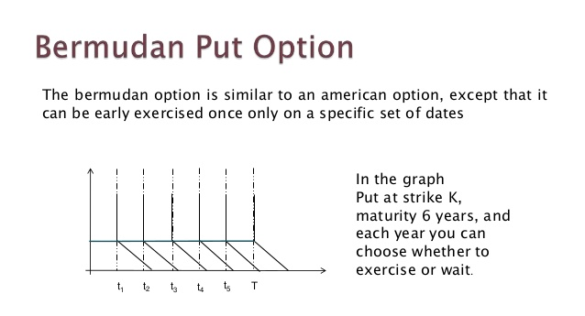
Fig 6.2: In this Bermudan put option, the expiration date is 6 years from now and the pre-set dates are the first calendar dates (say) of each of the 6 years.

Slide 28
Shout Option

Slide 29
Meaning
A shout option is an exotic option contract that allows the holder to lock in intrinsic value at defined intervals while maintaining the right to continue participating in gains without a loss of locked-in monies.
Suitability
For volatile underlying assets
Time of Expiration
As decided in the contract
Payoff
Call: Max (Spot price- strike price, shout price-strike price)
Put: Max (Strike Price-spot price, strike price-shout price)
Exercise Price
As fixed in the contract
Position
Call/Put as decided in the contract

Slide 30
Premium
More than standard options. Higher the premium, more the number of shouts
Underlying Asset
As decided in the contract
Types
Single shout
Multiple shouts
Illustration
For a call shout option, if the strike price is Rs.50 and the underlying asset trades to Rs.60 before expiration, the holder may "shout," or lock in the Rs.10 the option is trading in the money (ITM). The holder still keeps the call option and can make an additional profit if the underlying moves even higher before expiration.
However, if the underlying asset drops below Rs.60 before expiration, the holder still gets to exercise at Rs.60. The shout is useful for locking in gains if the buyer thinks the option may lose its intrinsic value, or simply to lock in profit as the option is increasing in value.

Slide 31
Asian Option

Slide 32
Meaning
An Asian option is an option type where the payoff depends on the average price of the underlying asset over a certain period of time as opposed to conventional options where the payoff depends on the spot price at maturity.
Suitability
1.Used by traders who are exposed to the underlying asset over some time.
2. When the underlying asset is highly volatile
3. When the pricing of the asset is not efficient due to a low liquidity
Time of Expiration
As decided in the Contract
Payoff
Call: Max (Average Price- Strike Price,0)
Put: Max (Strike Price – Average Price, 0)

Slide 33
Exercise Price
Based on the geometric or arithmetic mean of the asset prices over discrete intervals
Position
Call/ Put as decided in the contract
Risks
Limited to the premium paid
Premium
Less than standard options as volatility is less due to averaging mechanism
Underlying Asset
As decided in the contract

Slide 34
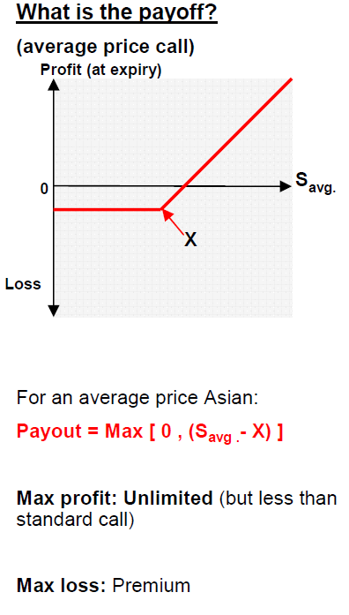
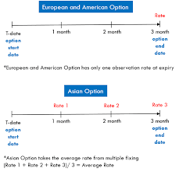
Fig. 8.2: In standard options the payoff depends on the spot at maturity and in Asian options, the payoff depends on the average prices over an observation period at discrete time intervals (here, 3 month period with 30-day intervals).
Fig 8.1: Payoff for an Asian Call option

Slide 35
Basket Option

Slide 36
Meaning
A basket option is a type of financial derivative where the underlying asset is a group, or basket, of commodities, securities or currency.
Suitability
When the risks of multiple assets are to be hedged in one transaction
Type of Option
These trade Over the Counter (OTC)
Time of Expiration
As decided in the Contract
Payoff
Call: Max (Spot Price of Basket – Strike Price of Basket, 0)
Put: Max (Strike Price of Basket- Spot Price of Basket, 0)
Exercise Price
It is based on the weighted value of the various components

Slide 37
Position
Can be Call/ Put as decided in the Contract
Types
Asian basket options
Lookback basket options
Average strike basket options
European basket options
American basket options
Bermudan basket options
Risks
Lack of liquidity
Underlying Asset
Basket of some/all of the following:
Securities
Commodities
Currencies

Slide 38
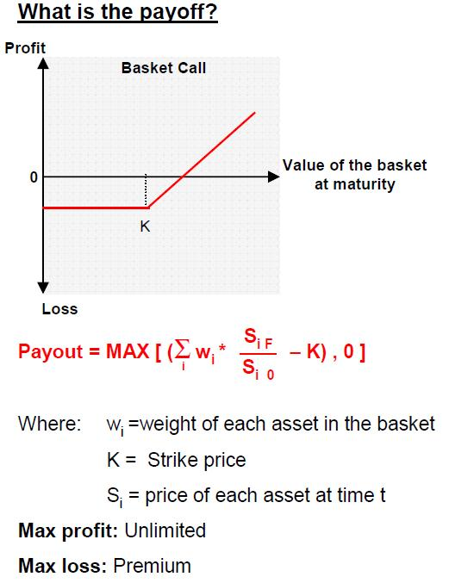
Fig. 9.1: Payoff for a Basket Call option

Slide 39


